Slide 1
Intro To Survival Analysis
Jesse Islam PhD student: QLS
Co-supervised by:
-Sahir Bhatnagar
-Robert Sladek
Notes:
Goal of this rotation was to really dive into a method rather than just apply it. I didn’t know which method so Dr. Bhatnagar mentioned a couple, and the one that spoke to me was survival analysis. Though I’ve gone over many aspects, during my rotation, I will only be introducing a small aspect of survival analysis along with the general qualitites of the data.

Slide 2
What is Survival Analysis?
Any dataset concerning time to an event.
Time to death
Time to graduation
Time to getting a disease
Dataset consists of individuals who were tracked for a fixed period of time.
The event is not necessarily experienced until the study is over.
The participant may drop out early for any reason.
These individuals are censored

Slide 3
Now lets gets some data!

Slide 4
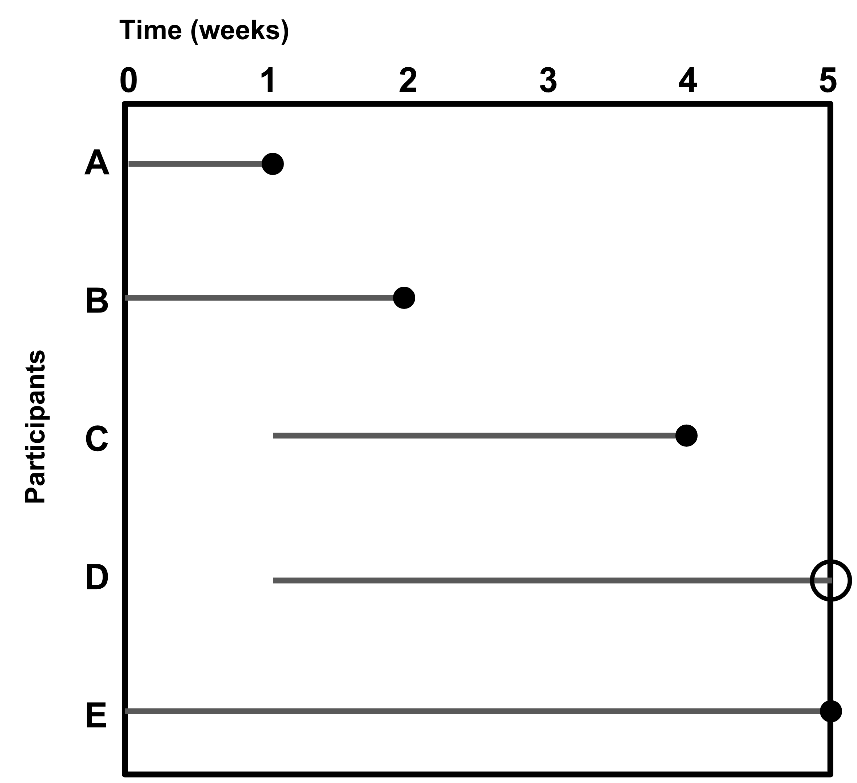
Data: Time to assignment completion

Slide 5
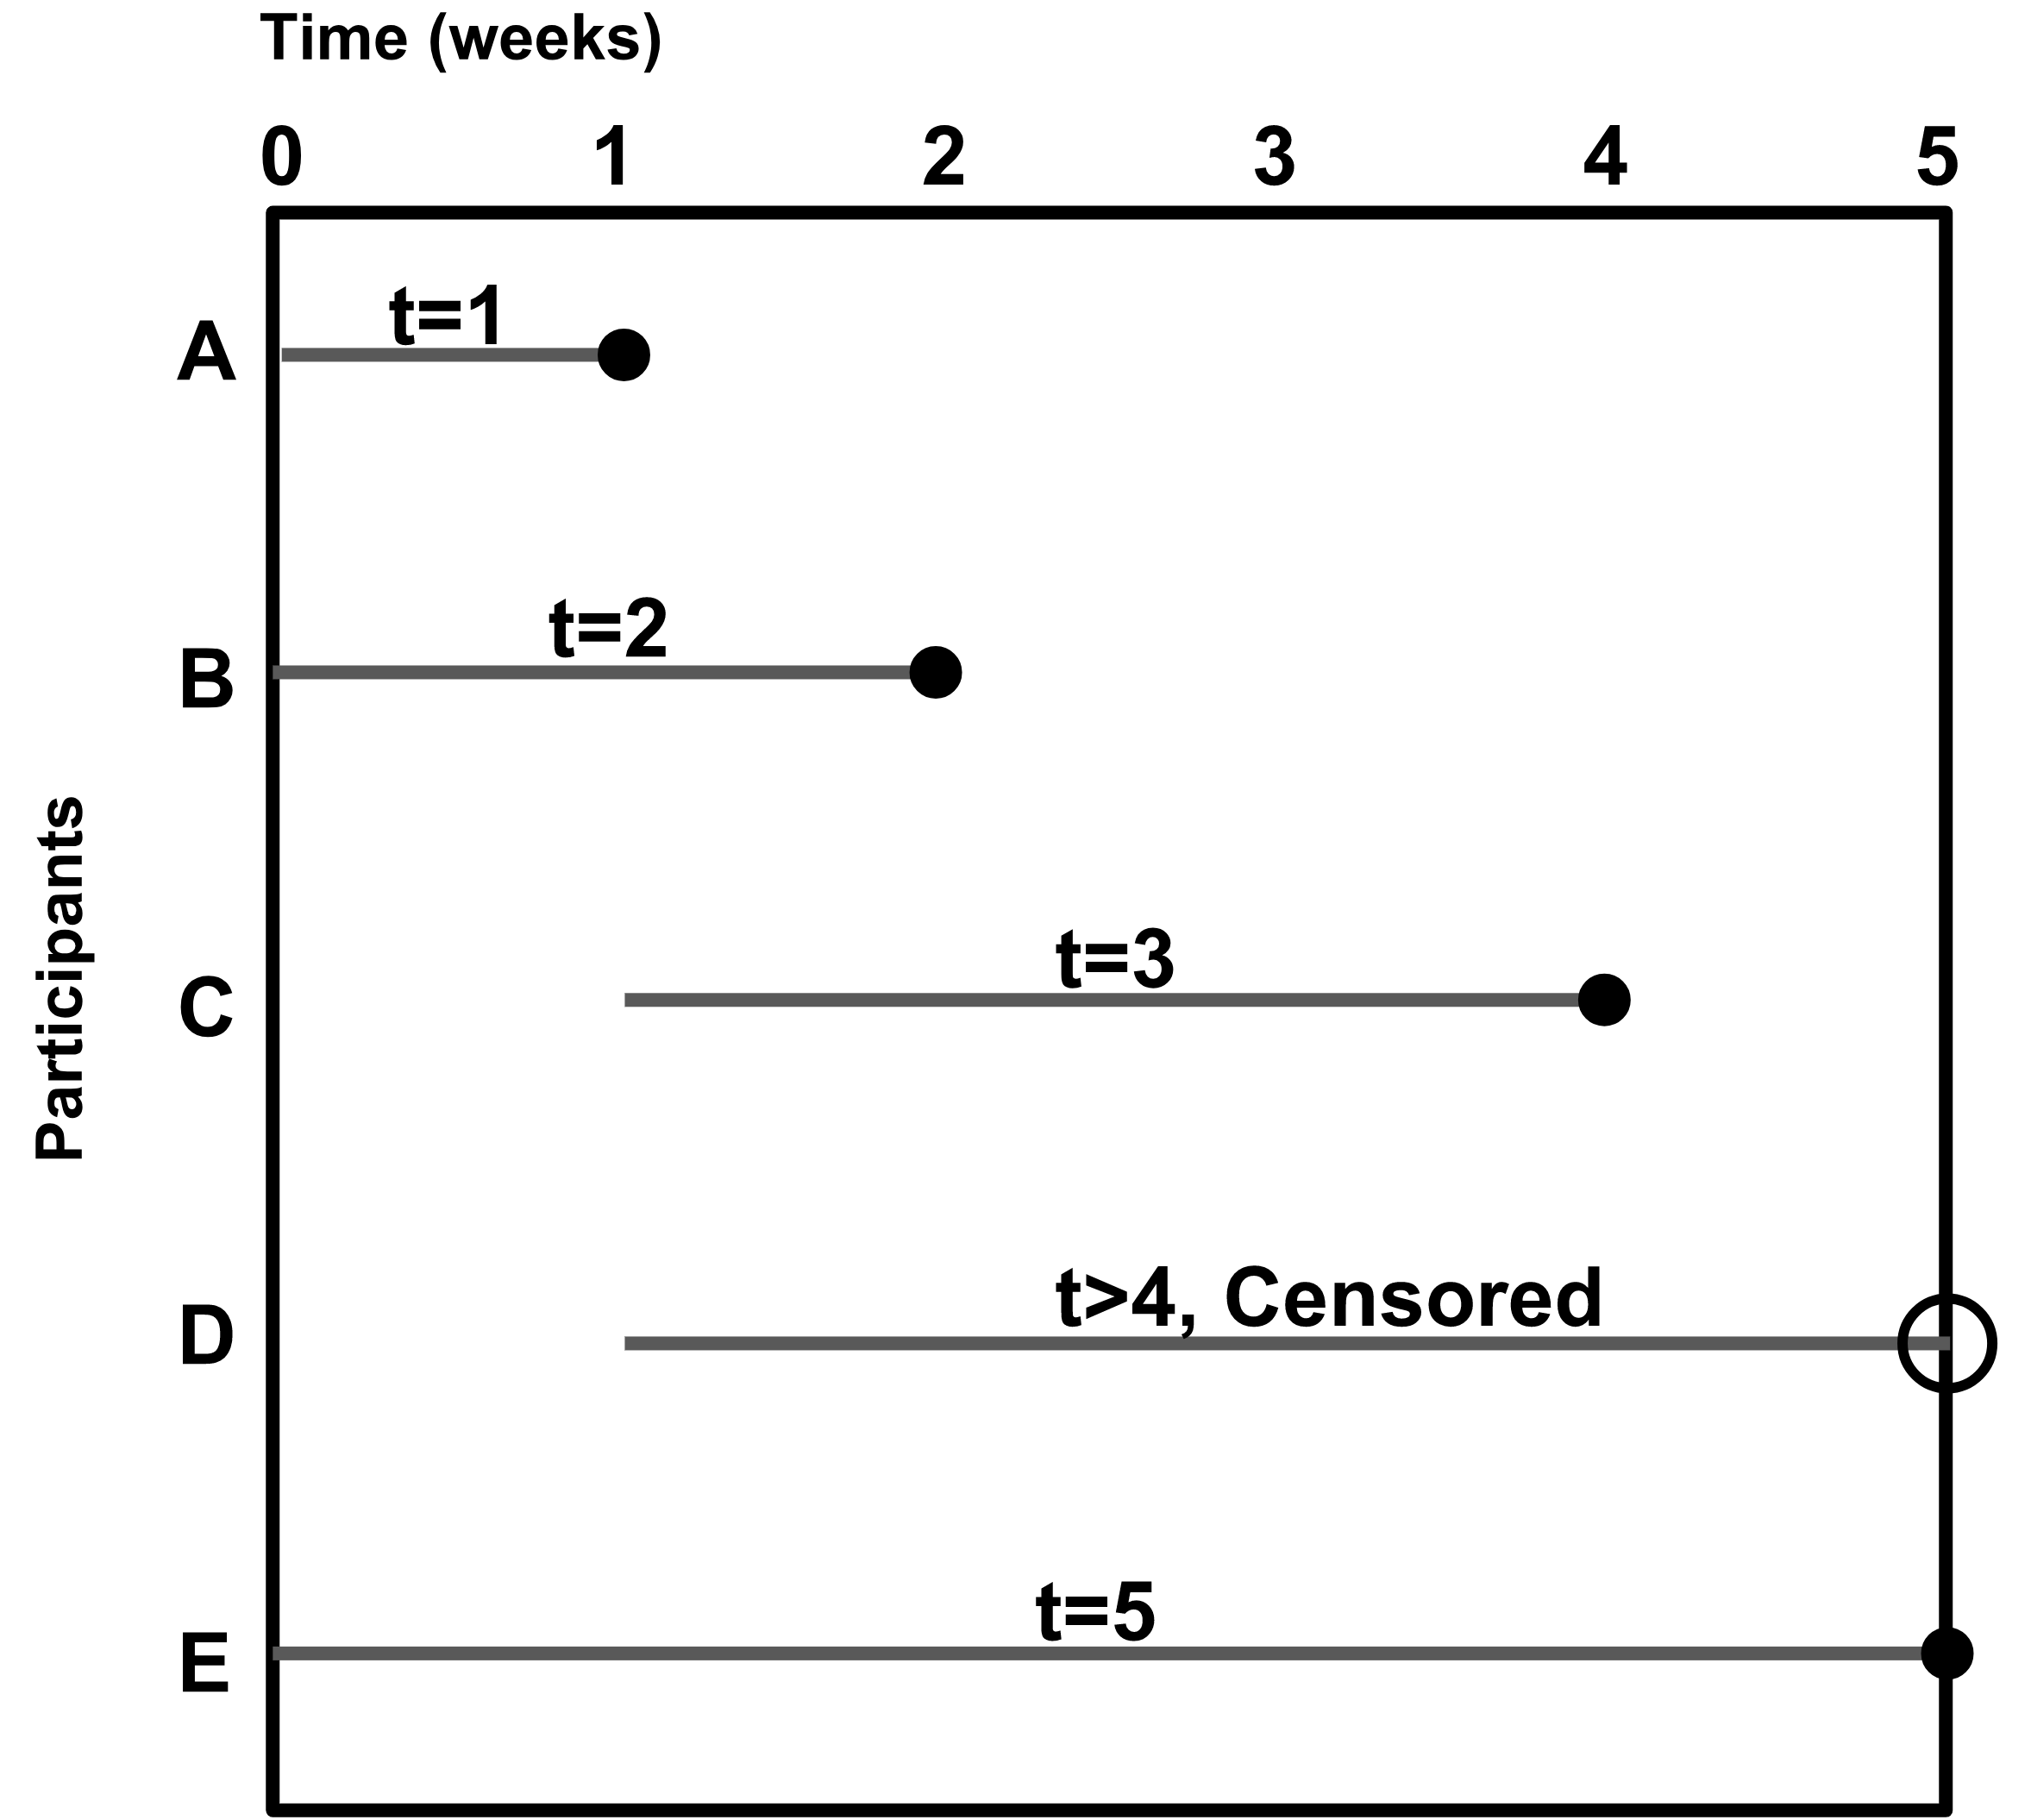
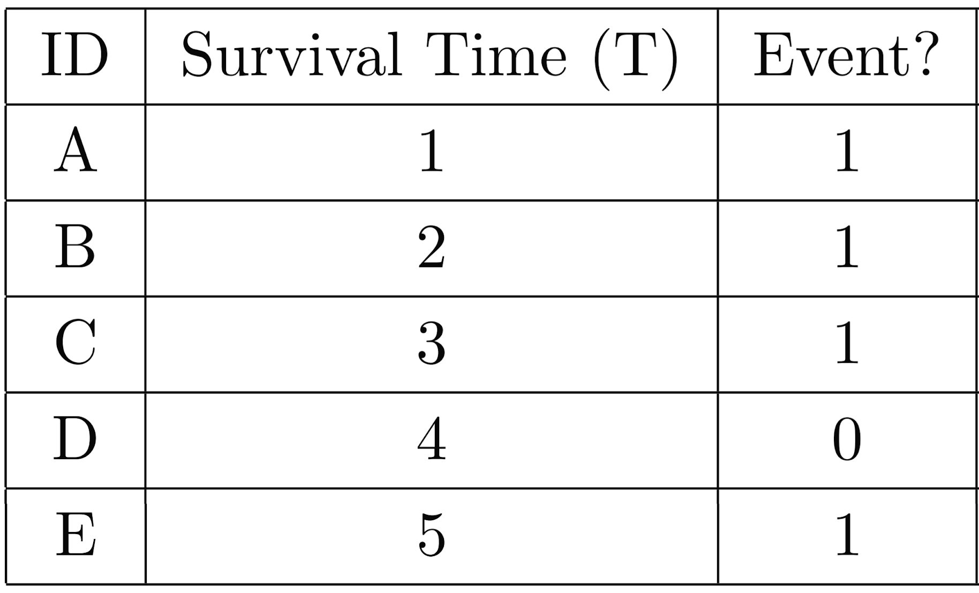
Data: Time to assignment completion
(t)
Censored: Individual may experience the event of interest after follow-up has ended.

Slide 6
Definitions/Notations
Survival: To persist without experiencing the event
T = Survival time (T > 0), Random variable
t = Current survival time

Slide 7
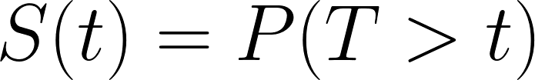
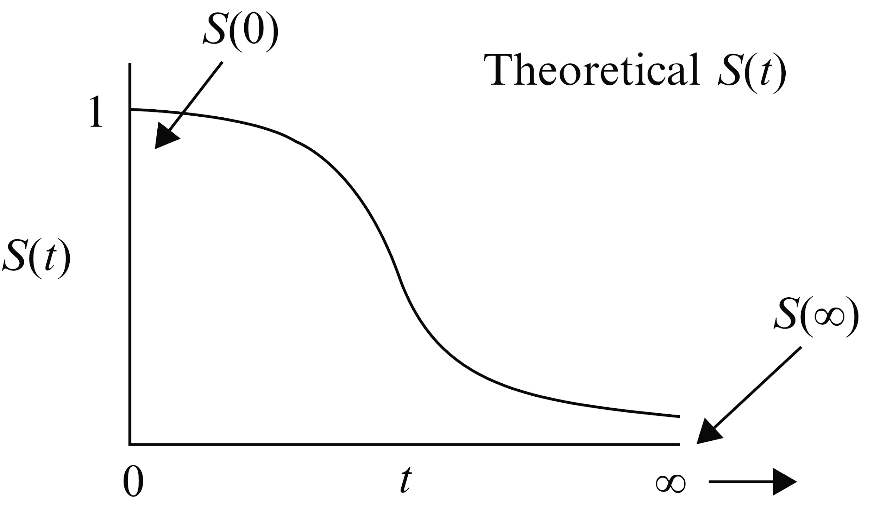
Survivor Function
Survivor function: probability of surviving past Survival time t.
Two things we care about:
Surviving past t.
Surviving at least t.
Kleinbaum, David G., and Mitchel Klein. Survival analysis. Vol. 3. New York: Springer, 2010. Pg. 9, 59

Slide 8
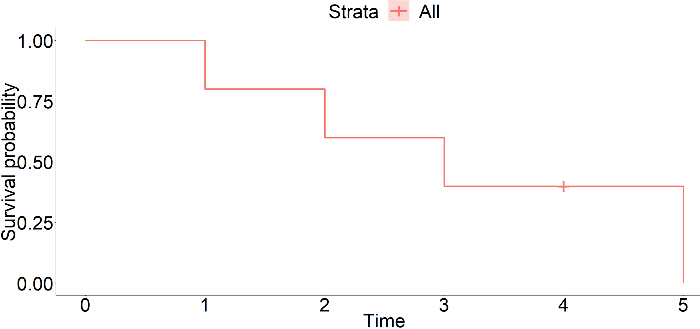
Step=0.2
Step=0.2
Censored individual
Step=0.2
Step=0.4

Slide 9

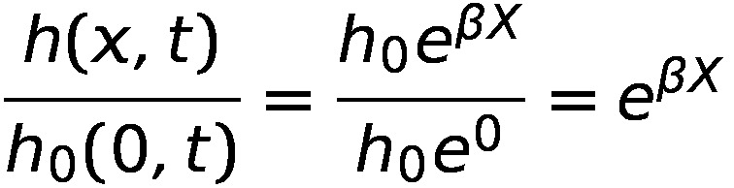
Hazard function Cox Hazard ratio
h(x,t) : hazard function. - Instantaneous potential of experiencing an event, given you have survived up to time t.
h₀ : baseline hazard
βX : linear predictor = L

Slide 10
Cox Overview AFT (parametric)
Etiology
Hazard ratio
Prognosis
Survival (absolute risk)

